Slide 1
Retrieval Augmented Generation (RAG)
evaluation

Slide 2
Query
Answer Relevance
Is the answer relevant to the query?
Context relevance
Is the retrieved context relevant to the query?
Response
Context
Groundedness
Is the response supported by the context?
basing on: https://www.trulens.org/getting_started/core_concepts/rag_triad/

Slide 3
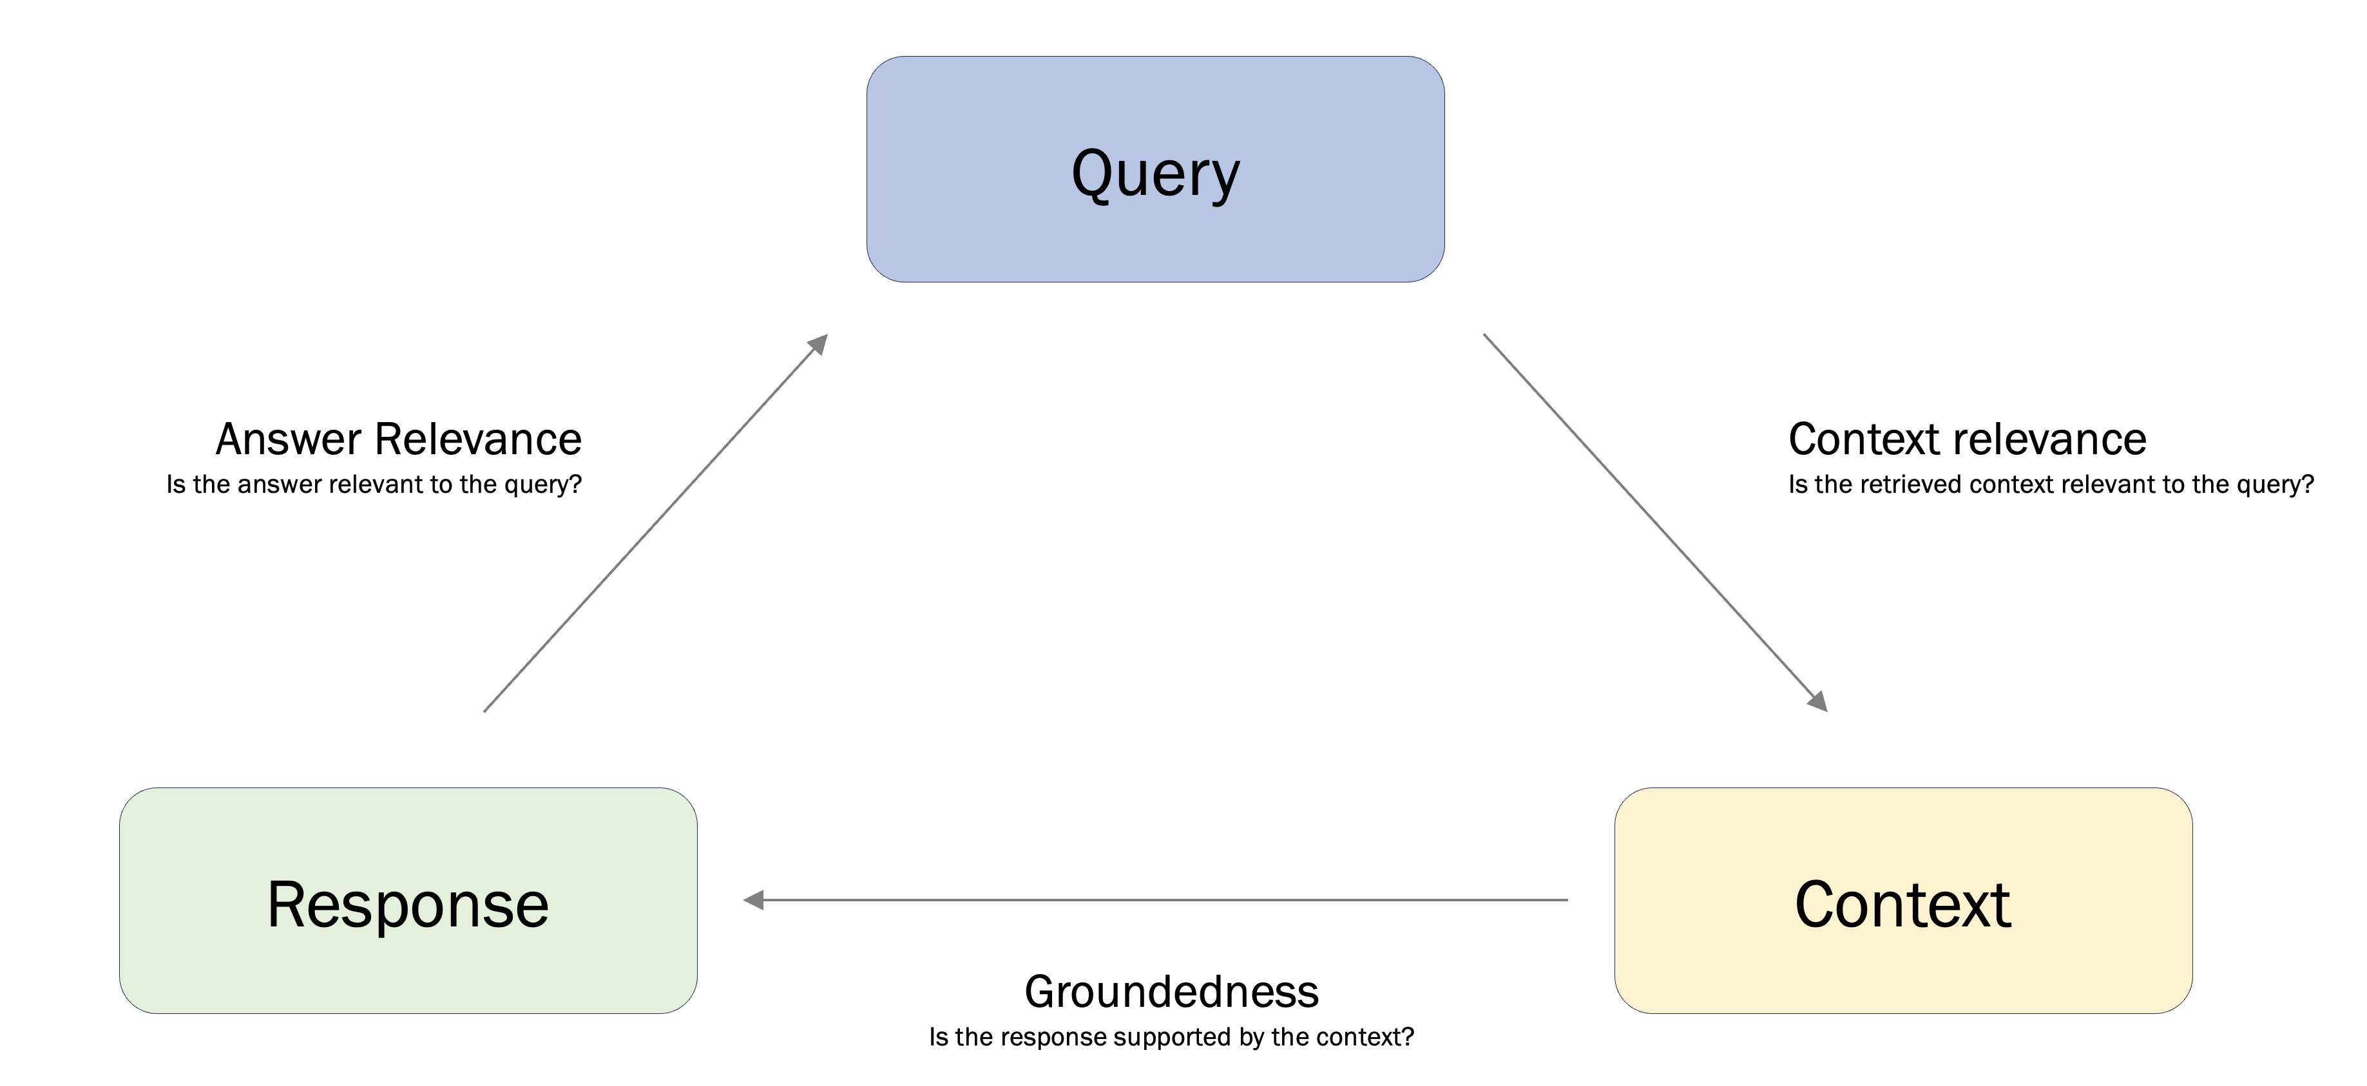
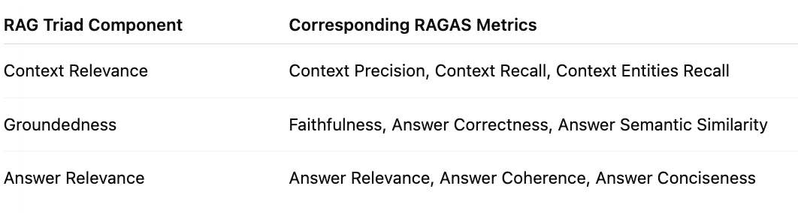

Slide 4
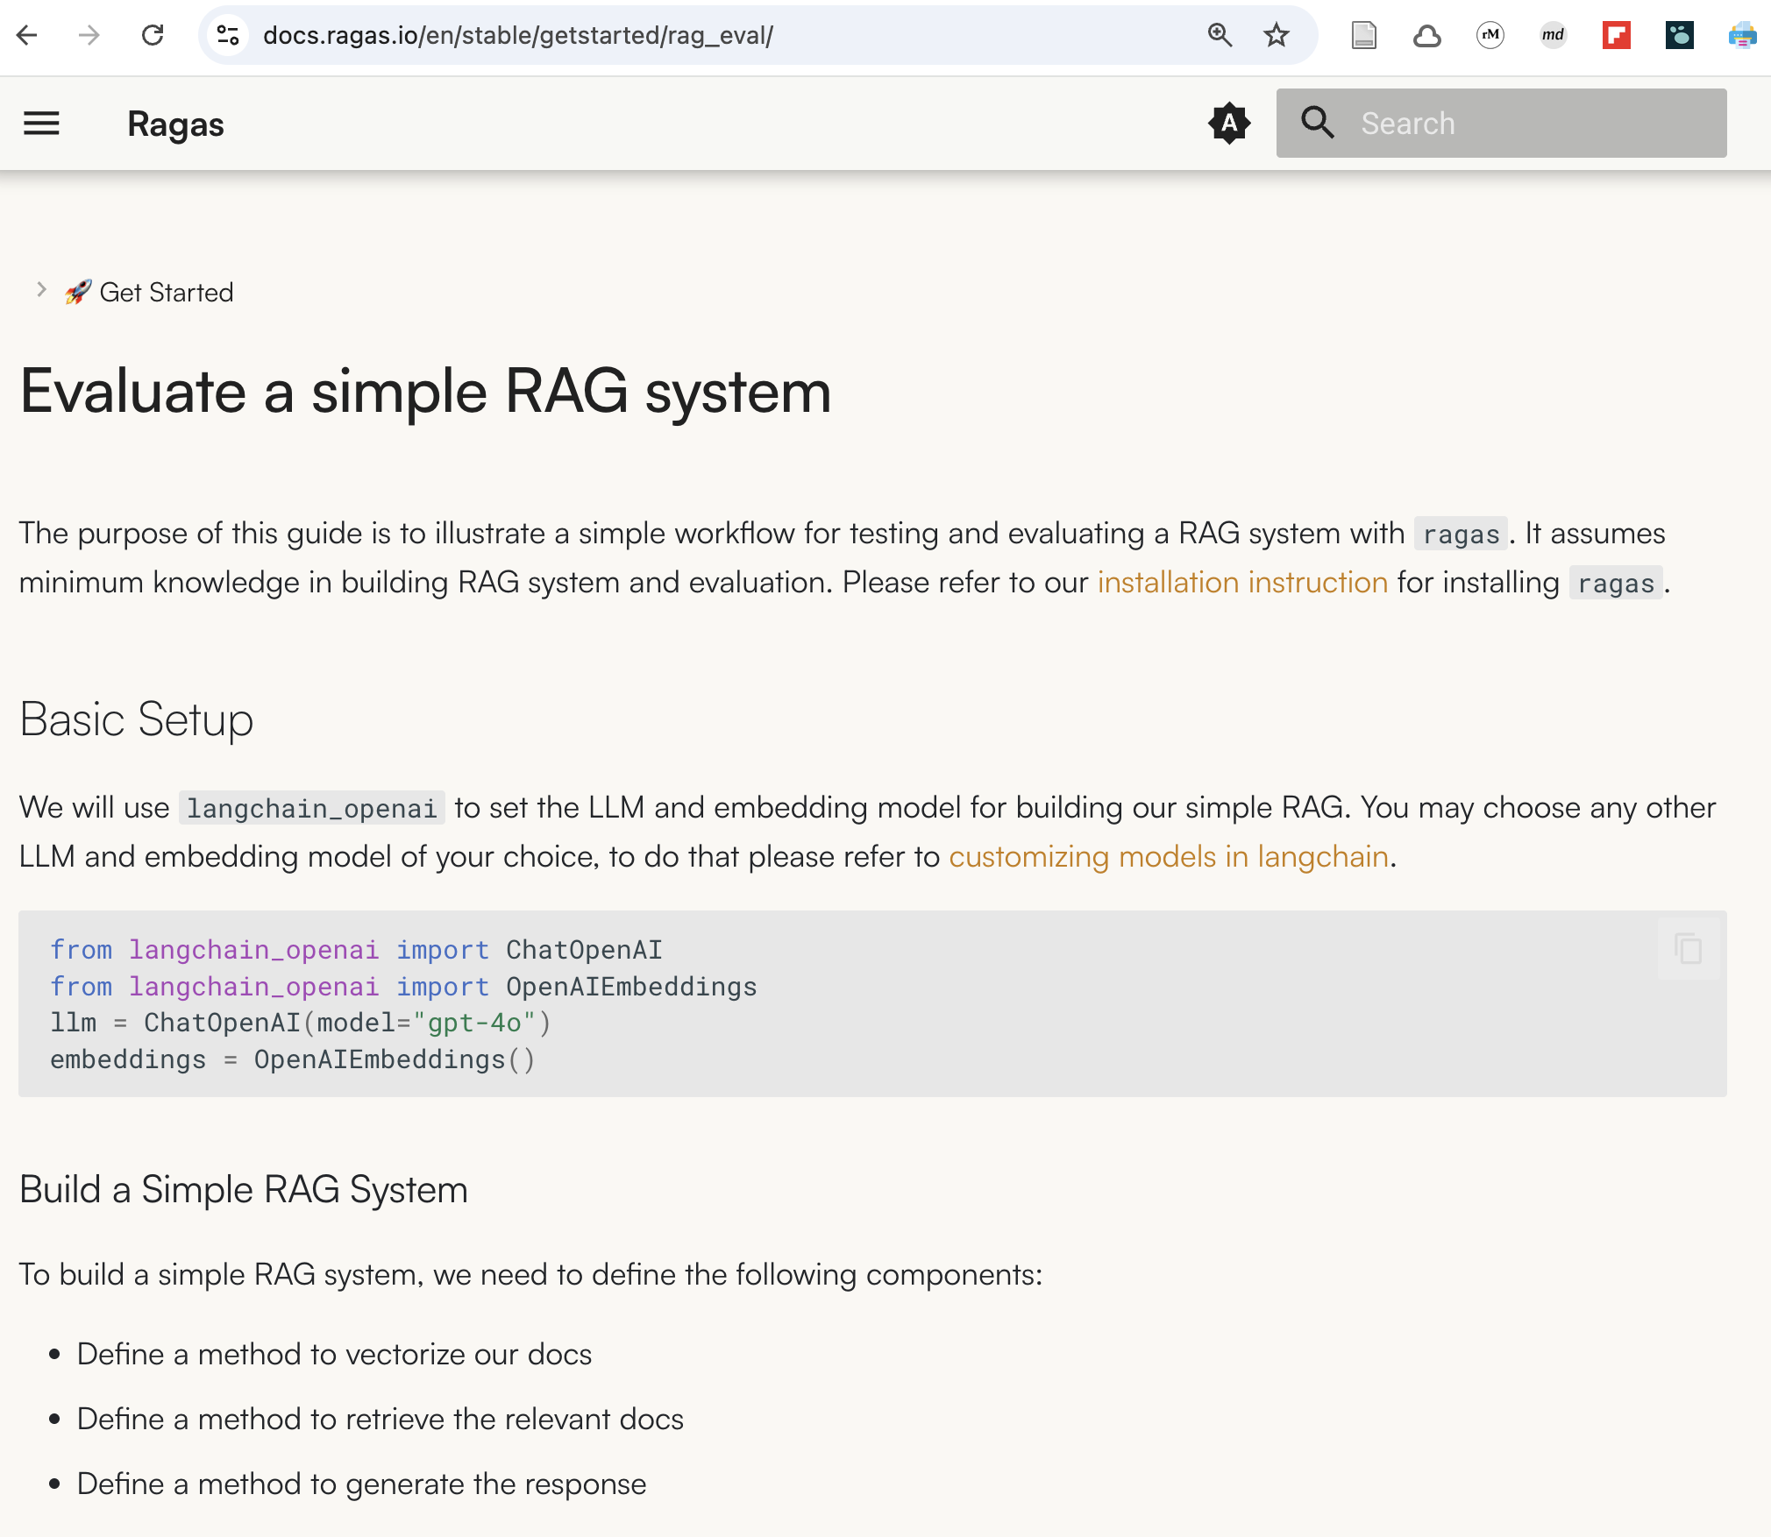

Slide 5
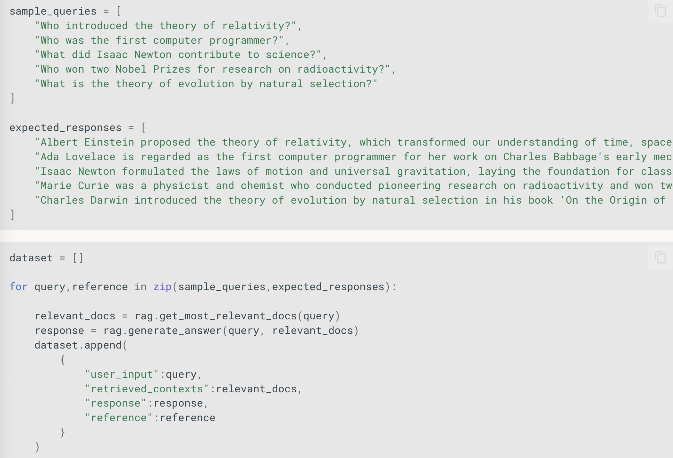

Slide 6
We need…
From experts:
Queries
Reference response (golden truth)
From RAG system:
Retrieved contexts
Responses

Slide 7
So, as always is it is about a data preparation…

Slide 8
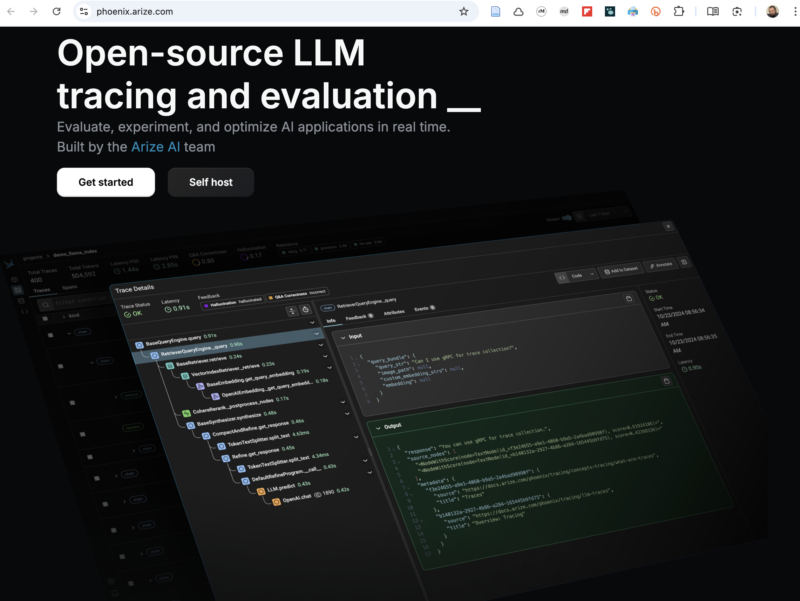
Monitor, analyze and evaluate with Arize Phoenix

Slide 9
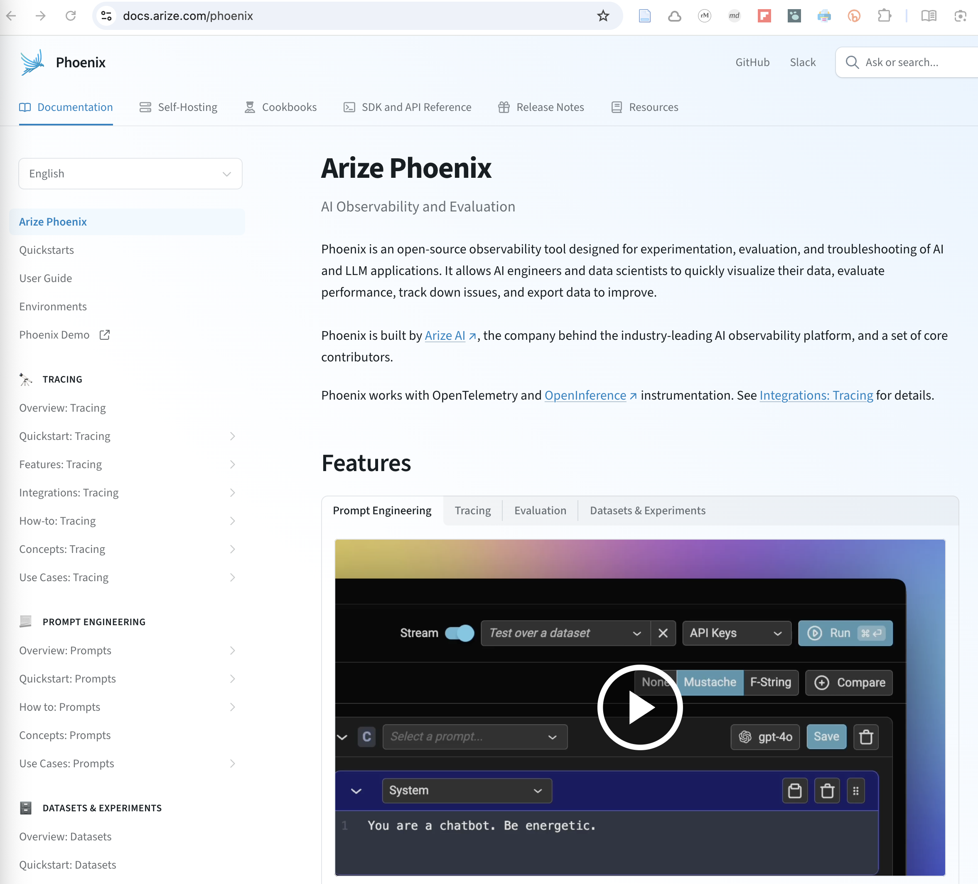
Monitor, analyze, evaluate and optimize with Arize Phoenix

Slide 10
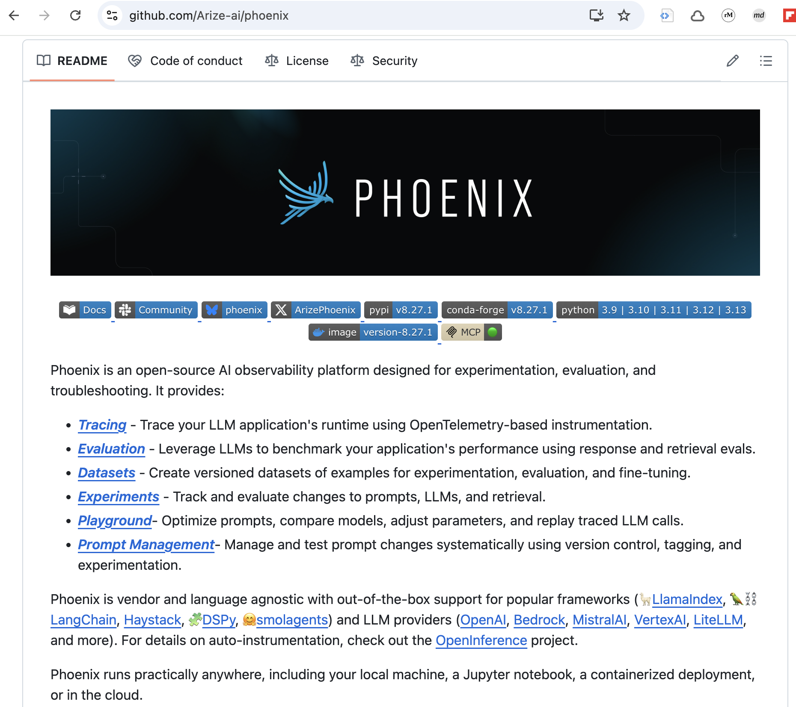
Monitor, analyze, evaluate and optimize with Arize Phoenix

Slide 11
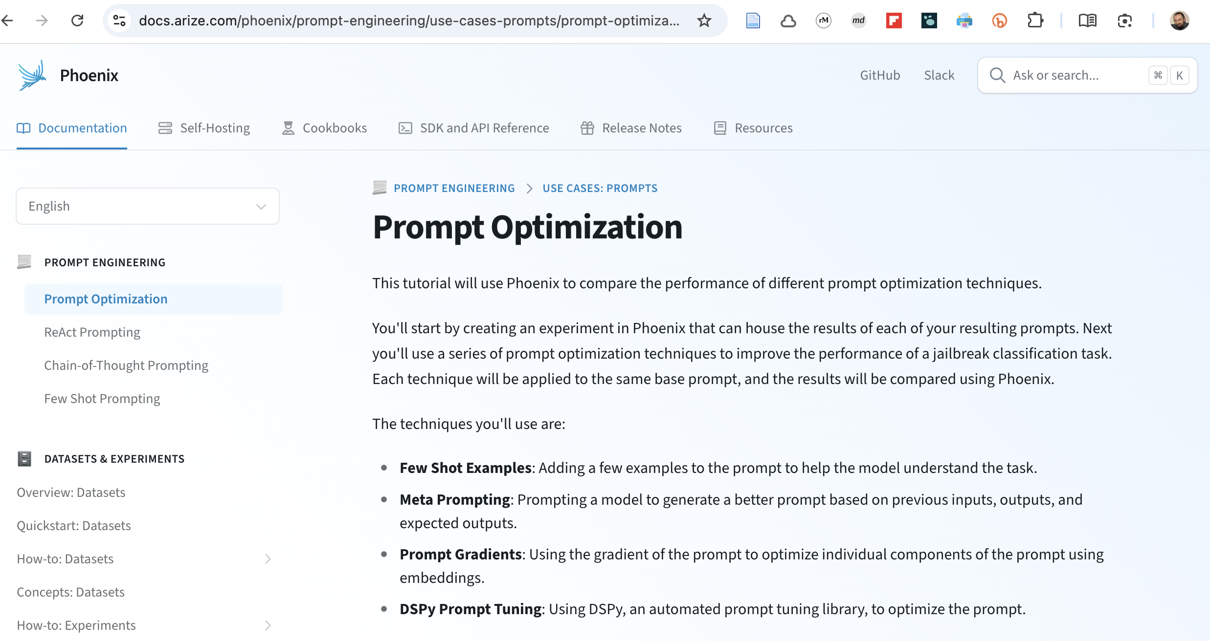
Monitor, analyze, evaluate and optimize with Arize Phoenix

Slide 12
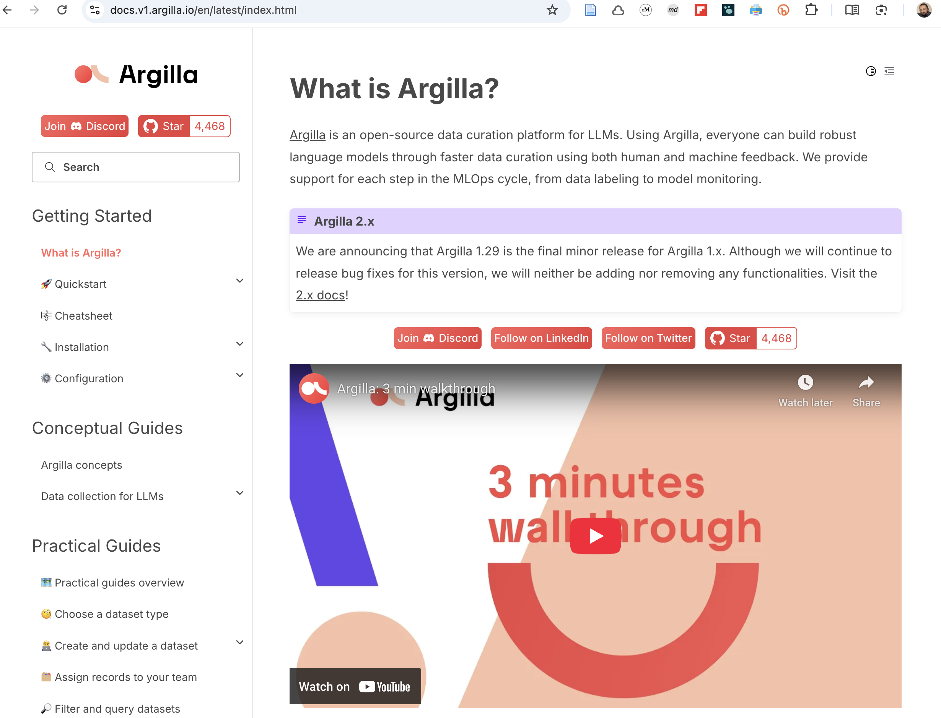
Gather feedback with Argilla

